Slide 1

SmartHirePRO
By Team Kodak

Slide 2
TABLE OF CONTENTS
01
Project Description and team working agreement
02
Personas and MVP
03
Technologies and algorithms
04
Diagrams
05
Backlogs
06
Team metrics
07
Demos

Slide 3




TEAM MEMBERS
Seungah Choi
Yadu Vamsi U.
Full Stack Developer
Full Stack Developer
Ashish Sudam
Sreeja Karukonda
Data Engineer
QA Analyst and DBA

Slide 4




TEAM MEMBERS
Aashlesha Shirole
Hrushikesh Joshi
Front-End Developer
Backend / Data Engineer
Yash Jani
Sujay Sail
Devops Engineer
Front-end Developer, Site reliability engineering (SRE)

Slide 5
IMPROVEMENTS FROM LAST SPRINT
Sprint backlog
Unified storyID and user stories ID
Every entries are now in story format
Story points are included in every slides + total points
Team metrics points and sprint backlog points are matching
Got rid of blinding colors
Team metrics Averages are included

Slide 6
PROJECT DESCRIPTION
01
Project Name | Smart Hire Pro
Team | Kodak
Project Description | Our project aims to create a job recommendation system that provides the user with a targeted list of jobs based on the skills and experience in the resume of the user.
Benefit Outcomes | Users can monitor their skill gaps to enhance their future job search strategies. The idea suggests an improved approach to applying or searching for job in the hopes of reducing failed job applications.
Github Link | https://github.com/htmw/2024S-Kodak/wiki

Slide 7
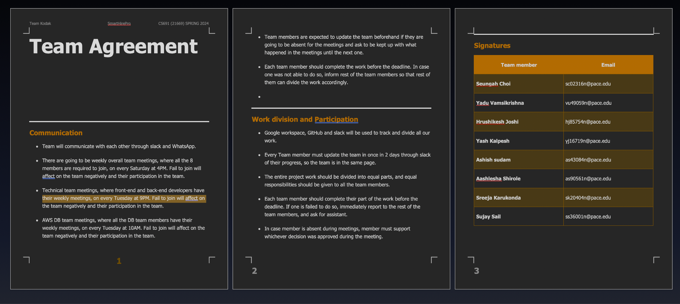
TEAM WORKING AGREEMENT

Slide 8
PERSONAS

Slide 9
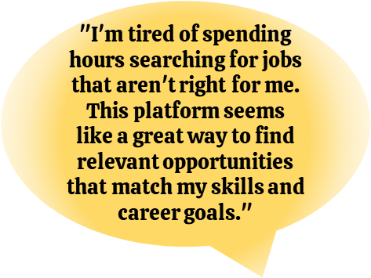

Maria, the Ambitious Software Engineer
●Demographics:
Age: 28
Location: London, UK
Education: Master's Degree in Computer Science
Experience: 3 years as a Software Developer
●Skills and Qualifications:
Proficient in Python, Java, and JavaScript
Experience with web development and machine learning
Strong analytical and problem-solving skills
Excellent communication and teamwork abilities
●Goals and Needs:
Looking for a challenging and rewarding software engineering role that utilizes her skills and experience.
Wants to find a job that aligns with her interests and career aspirations.
Struggles to stay up-to-date on the latest job openings and find relevant opportunities that match her profile.

Slide 10

Audrey, Film editor
●Demographics:
Age: 24
Location: Amsterdam, Netherlands
Education: Bachelor of Arts in Film and Screen studies
Experience: none
●Skills and Qualifications:
Proficient in adobe suites, and some Avid video editing
Experience with filming with 16mm camera
Strong communication and problem-solving skills
Great teamwork abilities
●Goals and Needs:
Searching for a full time opportunity that uses her degree
To have a personal assistant-like tool that will suggests as many jobs as there are in the market for her to aggressively apply right after college

Slide 11

Daiman, Technical Support Assistant
●Demographics:
Age: 27
Location: Birmingham, UK
Education: Bachelor's Degree in Information Technology
Experience: 2 yrs
●Skills and Qualifications:
Experience in Technical Support
Certified AWS CPP
100 hrs plus Data Science courses completed on Datacamp
Competed in multiple hackathons based on machine learning on HackerEarth
●Goals and Needs:
Determine to change career paths from technical support to a career in Data science
After countless unfruitful applications, looking job recommendations that encapsulates all his recently acquired skills

Slide 12
MVP
Core Functionality:
Resume Parsing:
Basic skill and experience extraction using pre-trained models or simple keyword matching.No complex semantic analysis or advanced natural language processing (NLP) at this stage
Job Search:
Connect to the external Jobseeker API using basic search capabilities based on extracted keywords from the resume.Initially, return a simple list of matching jobs without ranking or compatibility scoring.
User Interface:
Simple web interface:
Allow users to upload their resumes and receive a list of relevant job postings from reed.co.uk. No fancy features or complex navigation at this stage.
Metrics and Feedback:
Track basic usage metrics like number of users, resumes uploaded, and job searches conducted. Gather user feedback through surveys or interviews to understand their experience and pain points.
Key Learnings:
Validate the core concept of using Al to recommend jobs based on resumes.
Identify the most valuable features and functionalities to prioritize in future development.
Gain insights into user behavior and preferences to refine the product roadmap.

Slide 13
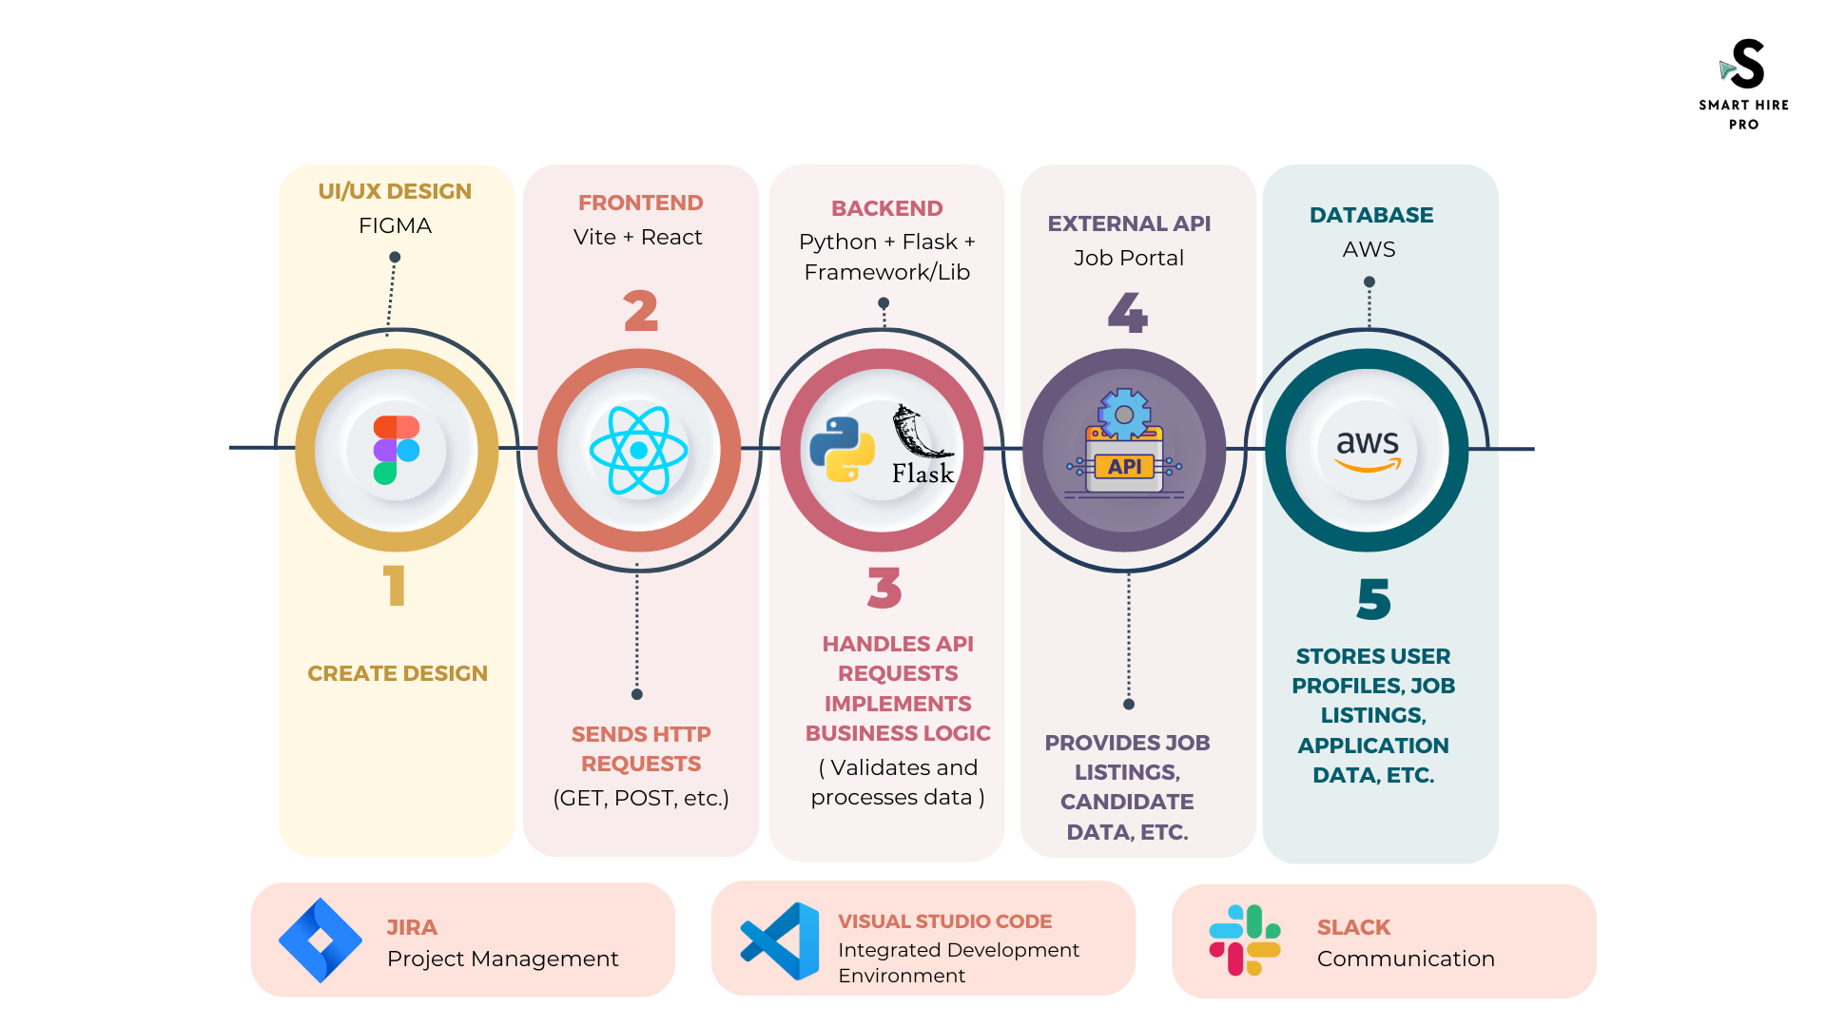
TECHNOLOGIES

Slide 14
ALGORITHMS
Text Extraction using Regular Expressions -
Contact number - (?:(?:\+?([1-9]|[0-9][0-9]|[0-9][0-9][0-9])\s*(?:[.-]\s*)?)?(?:\(\s*([2-9]1[02-9]|[2-9][02-8]1|[2-9][02-8][02-9])\s*\)|([0-9][1-9]|[0-9]1[02-9]|[2-9][02-8]1|[2-9][02-8][02-9]))\s*(?:[.-]\s*)?)?([2-9]1[02-9]|[2-9][02-9]1|[2-9][02-9]{2})\s*(?:[.-]\s*)?([0-9]{4})(?:\s*(?:#|x\.?|ext\.?|extension)\s*(\d+))?'
Email - ([^@|\s]+@[^@]+\.[^@|\s]+)

Slide 15
ALGORITHMS
Extract Name of Job-Seeker from Resume -
Load Spacy model - Initialize pre-trained small english language model (‘en_core_web_sm’)
Initialize Matcher - Matcher class of spacy is used to identify patterns in text
Tokenize text using nlp.
Define Pattern - Define a sequence of two proper nouns (PROPN)
Match Pattern - Using Matcher
Extract Name

Slide 16
ALGORITHMS
Extract keywords using YAKE (Yet Another Keyword Extraction) -
We chose this model after considering multiple models as we wanted to extract top keywords. YAKE provides a relevance score for keywords.
Algorithm -
Configure parameters for YAKE.
Compare extracted keywords with pre-defined skills
Use top n keywords for job search

Slide 17
ALGORITHMS
Generate a Match Score for a Job -
Another pre-trained Spacy model (‘en_core_web_lg’) is used to generate a Match Score for the resume and job.
Algorithm-
The model converts words in texts into high dimensional vectors i.e. Word Embeddings.
Then the process of Sentence Vectorization is performed.
Then similarity score is calculated for the sentence vectors using cosine similarity.

Slide 18
DIAGRAMS

Slide 19
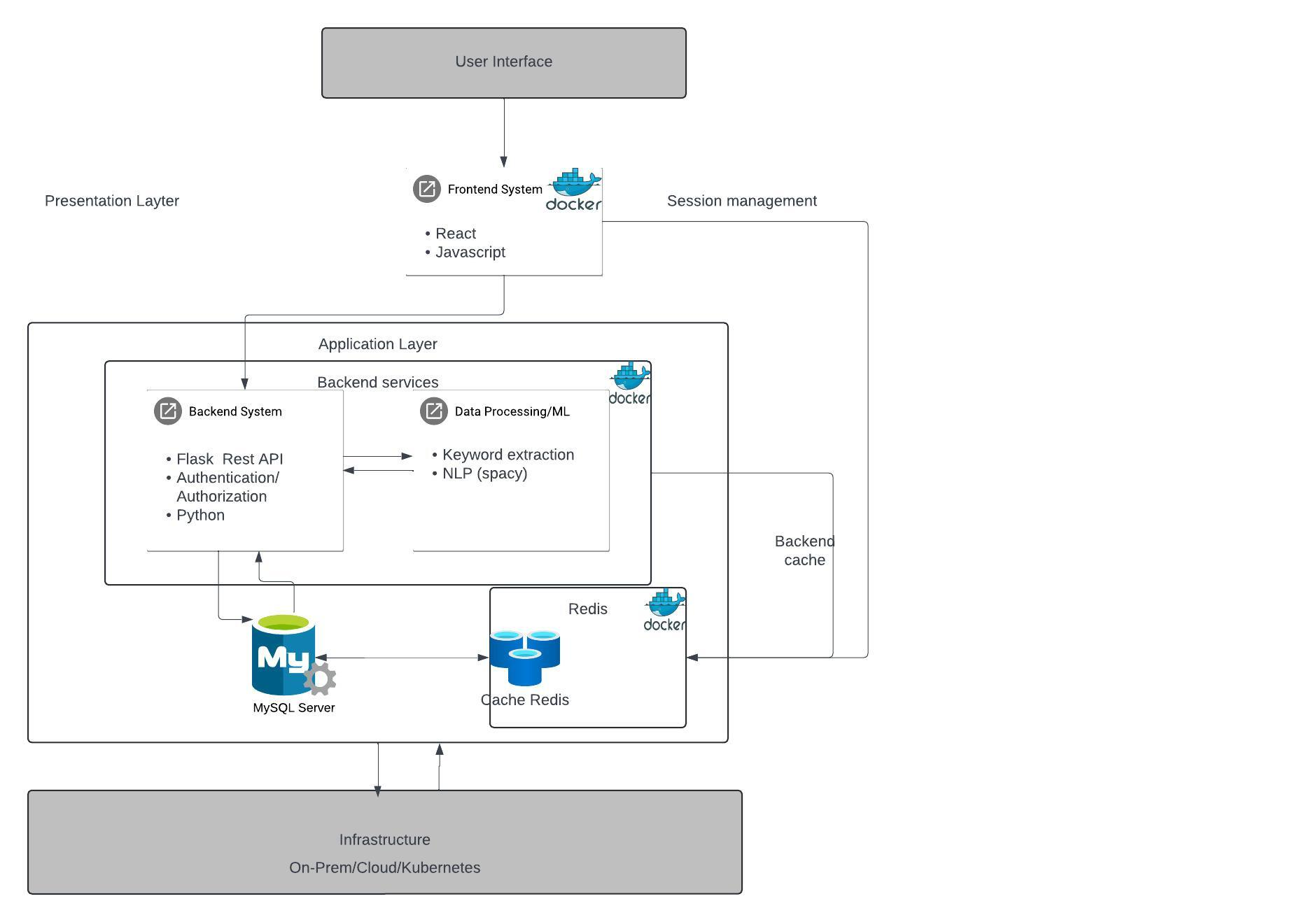
Architecture Diagram

Slide 20
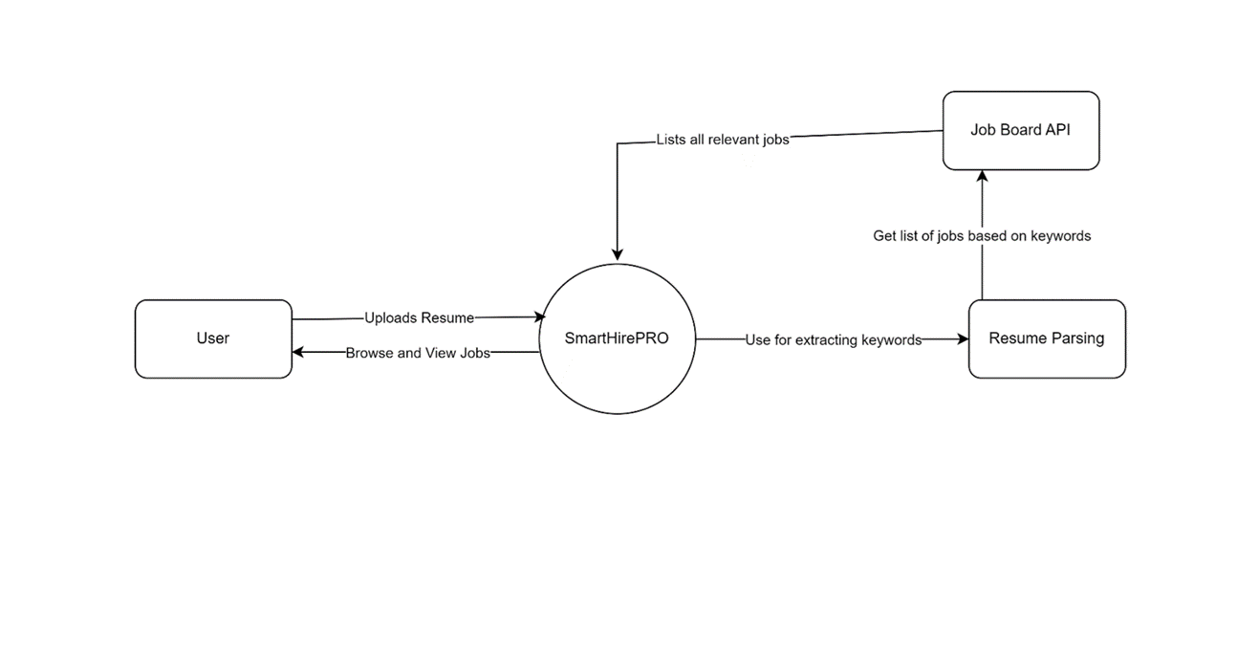
Context Diagram

Slide 21
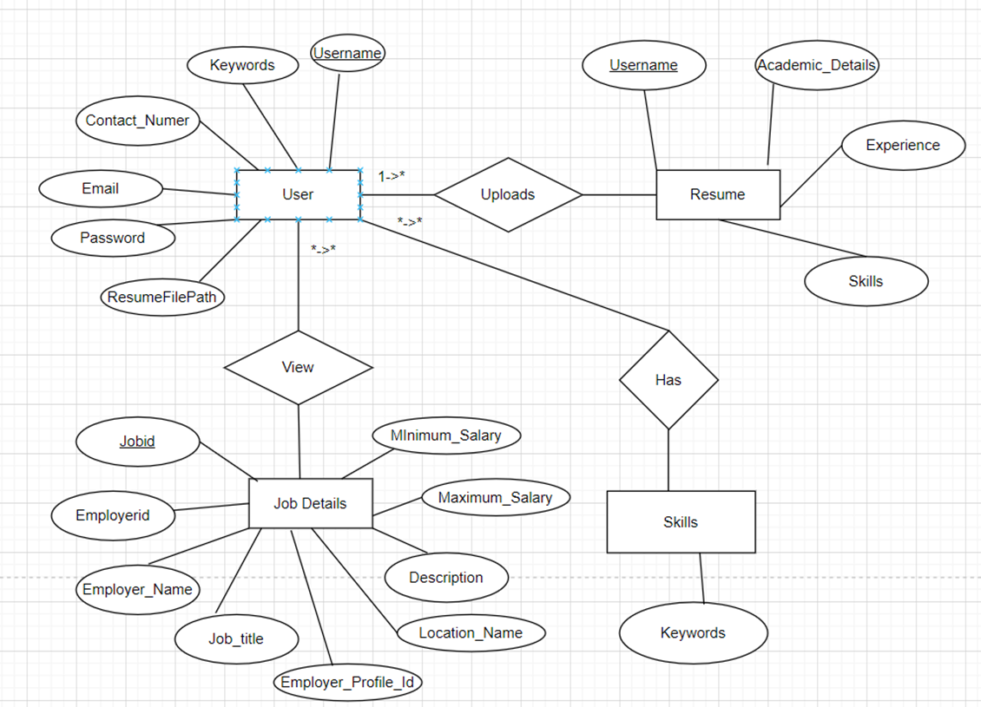
ER Diagram

Slide 22
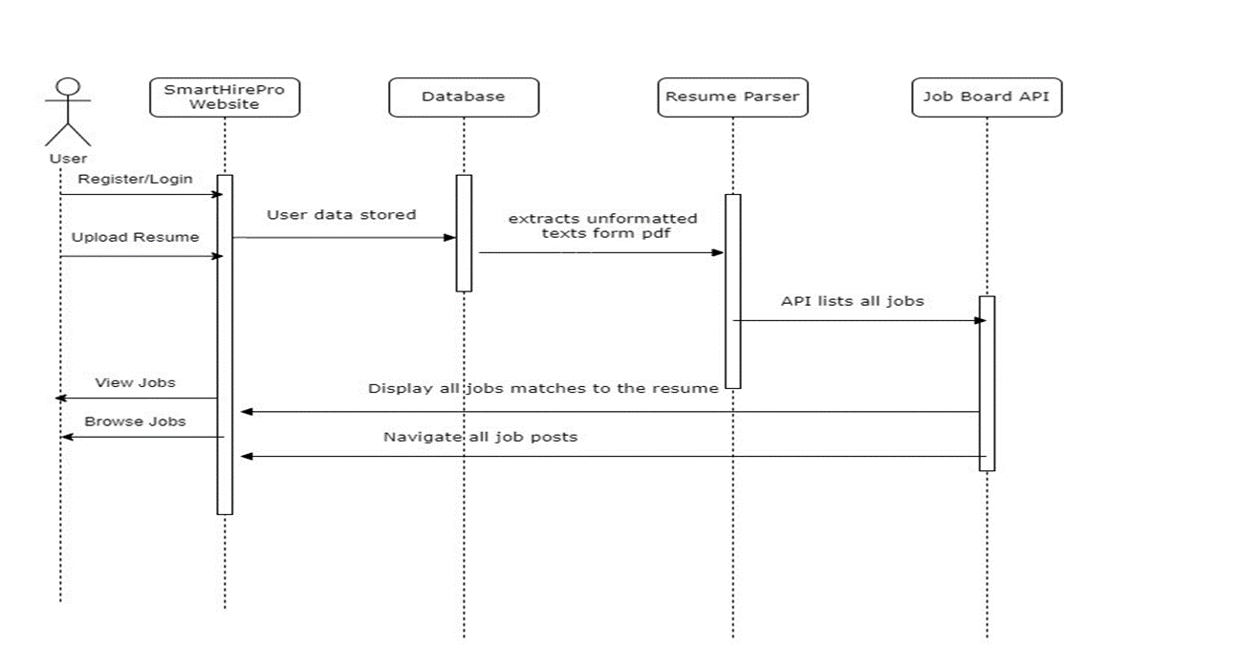
Sequence Diagram

Slide 23
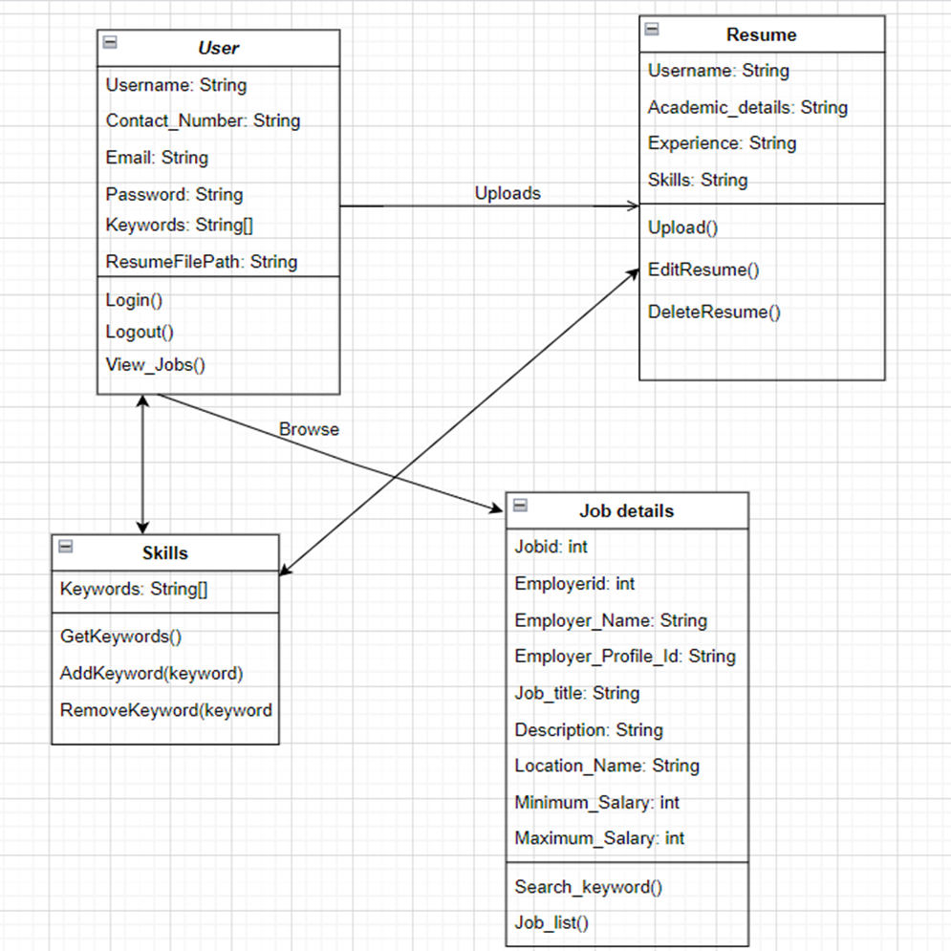
Class Diagram

Slide 24
Product Backlog
Story ID | User Stories | Story Point | Status
1 | As a software engineer, I want to be able to browse through Software engineer jobs so that I can review jobs that I want to apply. | 13 | Completed
2 | As an IT Student, I want to be able to upload my resume so that I get a list of jobs based on my skills. | 8 | Completed
3 | As a backend developer, I want to discover the values and detailed description of the employer and position so that I can determine if my interests and technical skills are aligned with the relevant job | 5 | Completed
4 | As a student, I want to be able to see the dashboard to view all available jobs so that I can easily find more jobs relevant to my profile. | 8 | Completed
5 | As a jobseeker, I want to be able to upload a new updated resume on the dashboard so that I can see the jobs as per my updated skills. | 1 | Completed

Slide 25
Product Backlog
Story ID | User Stories | Story Point | Status
6 | As a Java developer, I want to be able to login on Smarthirepro app so that I can search for new jobs related to my profile | 3 | Completed
7 | As a software engineer, I want to be able to register to Smarthirepro app and upload my resume so that I can navigate through all jobs. | 1 | Completed
8 | As a software engineer, I want to be able to browse through Software engineer jobs so that I can review jobs that I want to apply | 8 | Completed
9 | As a Technical Support Assistant, I want to switch my career path to data science so that I know I am applying for a job that matches my skills and is right for me. | 5 | Completed
10 | As a job seeker, I want to delve into the demands of the industry so that I can update myself to the industry standard. | 3 | Completed

Slide 26
Product Backlog
Story ID | User Stories | Story Point | Status
11 | As a student, I want to be able to search internship job lists so that I can browse internship opportunities relevant to my skills and apply. | 5 | Completed
12 | As a film editor, I want to devote my time to applying to only those jobs that suit my profile so that I increase my chances of getting hired. | 1 | Completed
13 | As a frontend developer, I want to access joblist with location so that I can find relevant jobs in my preferred location | 3 | Completed
14 | As an application developer i want to see a relevance score of the job and my profile so that I can enhance chances of getting hired. | 13 | Completed
15 | As a data analyst, i want to be able to get the details of the job from provided job list so that I can evaluate whether the position is good fit for my profile. | 5 | Completed

Slide 27
Product Backlog
Story ID | User Stories | Story Point | Status
16 | As a jobseeker, i want all the job recommendations in one place so that I can conveniently explore all relevant jobs. | 8 | Completed
17 | As a data engineer, i want to be able to browse through all available jobs in a single page so that I can quickly engage with job list according to my profile | 3 | Completed

Slide 28
User Stories
Story ID | User Stories | Acceptance Criteria | Status
1 | As a software engineer I want to be able to browse through Software engineer jobs so that I can review jobs that I want to apply. | Scenario: User is job hunting Given I'm a software engineer When I browse all jobs Then SmartHirePro should provide me with a list of relevant jobs. | Completed
2 | As an IT Student I want to be able to upload my resume so that I get a list of jobs based on my skills. | Scenario: User is seeking for jobs Given I'm an IT Student When I upload my resume Then I am provided with a curated list of IT-related jobs | Completed

Slide 29
User Stories
Story ID | User Stories | Acceptance Criteria | Status
3 | As a backend developer I want to discover the values and detailed description of the employer and position. so that I can determine if my interests and technical skills are aligned with relevant job | Scenario: User is seeking a job that encompasses his skills and interests Given I'm a backend developer When I review a job description Then I should see the details of the job with programming language specification | Completed
4 | As a student, I want to be able to see the dashboard to view all available jobs so that I can easily find more jobs relevant to my profile. | Scenario: User is seeking a job Given I'm a student When I browse through jobs Then I should see the dashboard easily accessible for browsing job list. | Completed

Slide 30
User Stories
Story ID | User Stories | Acceptance Criteria | Status
5 | As a jobseeker, I want to be able to upload a new updated resume on the dashboard so that I can see the jobs as per my updated skills. | Scenario: User is hunting for jobs Given I'm a job seeker When I upload new resume Then I should easily navigate through updated jobs on dashboard. | Completed
6 | As a Java developer, I want to be able to login on SmartHirePro app so that I can search for new jobs related to my profile | Scenario: User is seeking for jobs Given I'm Java developer When I login to app Then I should safely get login with my credentials. | Completed

Slide 31
User Stories
Story ID | User Stories | Acceptance Criteria | Status
7 | As a software engineer, I want to be able to register to SmartHirePro app and upload my resume so that I can navigate through all jobs. | Scenario: User is hunting for a job Given I'm a software engineer When I register for an app Then SmartHirePro should provide registration accessible with uploading resume | Completed
8 | As a software engineer, I want to be able to browse through Software engineer jobs so that I can review jobs that I want to apply | Scenario: User is hunting for a job Given I'm a software engineer When I register for an app Then SmartHirePro should provide registration accessible with uploading resume | Completed

Slide 32
User Stories
Story ID | User Stories | Acceptance Criteria | Status
9 | As a Technical Support Assistant I want to switch my career path to data science so that I know I am applying for a job that matches my skills and is right for me. | Scenario: User is hunting for a job in another domain Given I'm a technical support assistant When I browse through a job Then SmartHirePro should provide job match and skills score for data science jobs | Completed
10 | As a job seeker I want to delve into the demands of the industry so that I can update myself to the industry standard. | Scenario: User wants to investigate jobs Given I'm a job seeker When I navigate through jobs Then I can investigate the demands of job categories in the industry. | Completed

Slide 33
User Stories
Story ID | User Stories | Acceptance Criteria | Status
11 | As a student I want to be able to search internship job list so that I can browse internship opportunities relevant to my skills and apply. | Scenario: User is seeking an internship Given I'm a student When I see a job that is a match for my profile Then SmartHirePro should provide me list of internship opportunities | Completed
12 | As a film editor I want to devote my time to applying to only those jobs that suit my profile so that I increase my chances of getting hired. | Scenario: User is on a deadline for job hunting Given I'm a film editor When I am hunting for jobs Then I want to browse jobs that are suitable for my profile and skills match score | Completed

Slide 34
User Stories
Story ID | User Stories | Acceptance Criteria | Status
13 | As a frontend developer, I want to access joblist with location so that I can find relevant jobs in my preferred location | Scenario: User is seeking job in his place Given I'm a frontend developer When I am hunting for jobs Then I want to browse jobs that are suitable for me to my preferred job location. | Completed
14 | As an application developer, I want to see a relevance score of the job and my profile so that I can enhance chances of getting hired. | Scenario: User is hunting for a job related to his profile Given I'm an application developer When I am review job description Then SmartHirePro should provide me job match and skills score | Completed

Slide 35
User Stories
Story ID | User Stories | Acceptance Criteria | Status
15 | As a data analyst, I want to be able to get the details of the job from provided job list so that I can evaluate whether the position is good fit for my profile. | Scenario: User wants to investigate jobs details Given I'm a data analyst When I navigate through job description Then I should view details of job to evaluate my interest of technical skills. | Completed
16 | As a jobseeker, I want all the job recommendations in one place so that I can conveniently explore all relevant jobs. | Scenario: User is seeking job Given I'm a jobseeker When I am hunting for jobs Then I should navigate all available jobs that are suitable for me on same page only. | Completed

Slide 36
User Stories
Story ID | User Stories | Acceptance Criteria | Status
17 | As a data engineer, I want to be able to browse through all available jobs in a single page so that I can quickly engage with job list according to my profile | Scenario: User is seeking job Given I'm a data engineer When I am navigating jobs dashboard Then I should explore all opportunities of my preference at a glance. | Completed

Slide 37
Sprint 2 Summary
Story ID | User Stories | Story Point | Status
1 | As a software engineer, I want to be able to browse through Software engineer jobs so that I can review jobs that I want to apply. | 13 | Completed
2 | As an IT Student, I want to be able to upload my resume so that I get a list of jobs based on my skills. | 8 | Completed
3 | As a backend developer, I want to discover the values and detailed description of the employer and position so that I can determine if my interests and technical skills are aligned with the relevant job | 5 | Completed
4 | As a student, I want to be able to see the dashboard to view all available jobs so that I can easily find more jobs relevant to my profile. | 8 | Completed
5 | As a jobseeker, I want to be able to upload a new updated resume on the dashboard so that I can see the jobs as per my updated skills. | 1 | Completed

Slide 38
Sprint 2 Summary Cont.
Story ID | User Stories | Story Point | Status
6 | As a Java developer, I want to be able to login on Smarthirepro app so that I can search for new jobs related to my profile | 3 | Completed
7 | As a software engineer, I want to be able to register to Smarthirepro app and upload my resume so that I can navigate through all jobs. | 1 | Completed
 | Total | 39

Slide 39
Sprint 3 Summary
Story ID | User Stories | Story Point | Status
8 | As a software engineer, I want to be able to browse through Software engineer jobs so that I can review jobs that I want to apply | 8 | Completed
9 | As a Technical Support Assistant, I want to switch my career path to data science so that I know I am applying for a job that matches my skills and is right for me. | 5 | Completed
10 | As a job seeker, I want to delve into the demands of the industry so that I can update myself to the industry standard. | 3 | Completed
11 | As a student, I want to be able to search internship job lists so that I can browse internship opportunities relevant to my skills and apply. | 5 | Completed
12 | As a film editor, I want to devote my time to applying to only those jobs that suit my profile so that I increase my chances of getting hired. | 1 | Completed
13 | As a frontend developer, I want to access joblist with location so that I can find relevant jobs in my preferred location | 3 | Completed
 | Total | 25

Slide 40
Sprint 4 Backlog
Story ID | User Stories | Story Point | Status
14 | As an application developer i want to see a relevance score of the job and my profile so that I can enhance chances of getting hired. | 13 | Completed
15 | As a data analyst, i want to be able to get the details of the job from provided job list so that I can evaluate whether the position is good fit for my profile. | 5 | Completed
16 | As a jobseeker, i want all the job recommendations in one place so that I can conveniently explore all relevant jobs. | 8 | Completed
17 | As a data engineer, i want to be able to browse through all available jobs in a single page so that I can quickly engage with job list according to my profile | 3 | Completed
 | Total | 29

Slide 41
Test Cases
Test Case ID | User Story ID | Test Scenario | Feature | Description | Expected Outcome | Actual Outcome | Pass/Fail | Comments
1 | 14 | Users view the relevance score of job listings through a pie chart on the job details page. | Relevance Score Visualization | Job details page with a pie chart representing the relevance score. | The relevance score pie chart should be visually appealing, clearly indicating the relevance score. | The relevance score pie chart is displayed on the job details page. | Pass

Slide 42
Test Cases
Test Case ID | User Story ID | Test Scenario | Feature | Description | Expected Outcome | Actual Outcome | Pass/Fail | Comm-ents
2 | 15 | Retrieve Job Details Using Job ID API Endpoint | Job Search and Details Retrieval | Access to the job search application. A genuine job ID is in the system. | The app should successfully connect to the API endpoint for job details using the provided job ID. | The displayed job information matches the expected details based on the provided job ID. | Pass

Slide 43
Test Cases
Test Case ID | User Story ID | Test Scenario | Feature | Description | Expected Outcome | Actual Outcome | Pass/Fail | Comm-ents
3 | 16 | I want all the job recommendations in one place so that I can explore all relevant jobs. | Job Recommendations Integration | Navigating through the job recommendations section or feature. | The job recommendations section should present all relevant job listings in one place. | Relevent job listings are displayed | Pass

Slide 44
Test Cases
Test Case ID | User Story ID | Test Scenario | Feature | Description | Expected Outcome | Actual Outcome | Pass/Fail | Comments
4 | 17 | Data Engineer hunting for jobs | Dashboard | Able to browse through all available jobs on single page | SmartHirePro should provide relevant job list on same page. | List of jobs displayed on same page | Pass

Slide 45
Sprint 4 Story Completion
Estimation | User Story ID | As a | I Want | So That | Feature | Status
13 | 14 | As a user, | I want the relevance score of job listings to be visually represented using a pie chart, | So that I can quickly understand the relevance distribution of job listings at a glance. | Relevance Score Pie Chart UI Representation | Completed
5 | 15 | As a, user of my job search app, | I want to retrieve detailed information about a specific job using its unique job ID | So that I can gather details about the job and make informed decisions about applying or pursuing further information. | Job Details Retrieval via API Endpoint | Completed

Slide 46
Sprint 4 Story Completion
Estimation | User Story ID | As a | I Want | So That | Feature | Status
8 | 16 | As a job seeker, | I want all the job recommendations to be consolidated in one place | So that I can conveniently explore all relevant jobs without the need to search through multiple pages or sections. | Job Recommendation system | Completed
3 | 17 | As a Data Engineer hunting for jobs, | I want SmartHirePro to provide a relevant job list on the same page | So that I can quickly review and apply for suitable job opportunities without navigating to multiple pages. | Job List Display | Completed

Slide 47
TEAM KODAK’S SPRINT 4 VELOCITY
Committed
Completed
30
29
29
25
20
15
10
5
0

Slide 48
TEAM KODAK’S HISTORICAL VELOCITY + AVERAGE
Sprint 2
Sprint 3
Sprint 4
Average
40
39
39
30
Average
Committed: (39+25+29)/3 = 31 Completed:
(39+19+29)/3
= 29
31
29
29
29
25
25
20
19
15
10
5
0

Slide 49
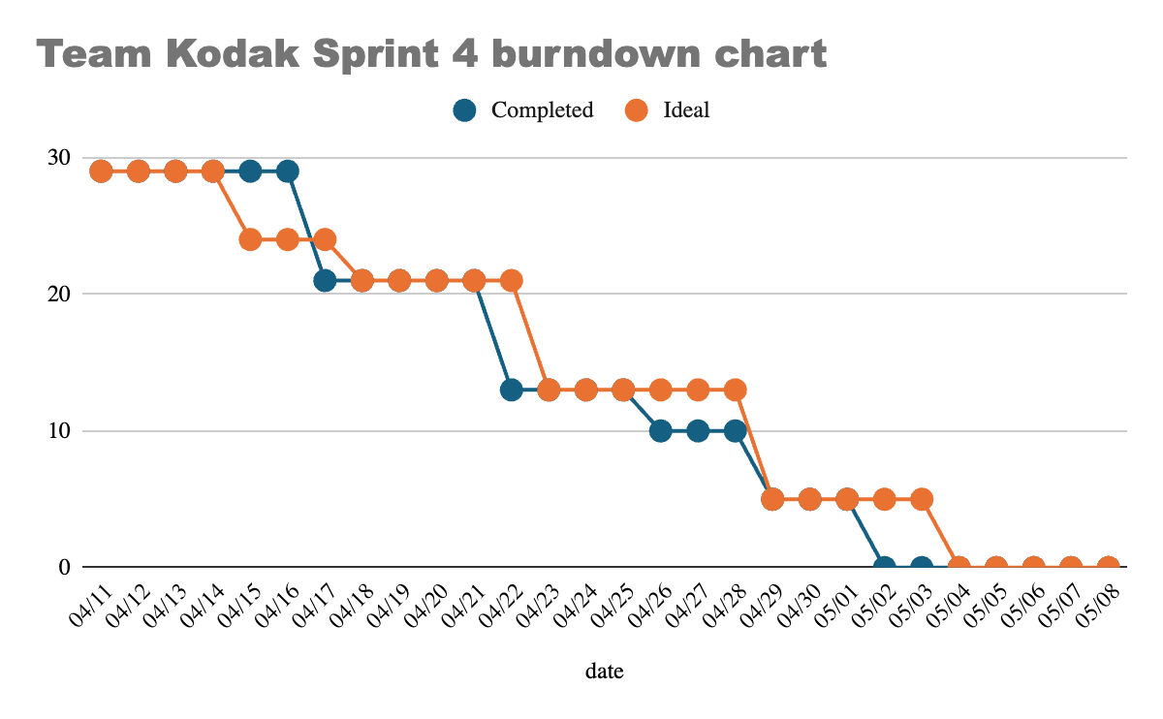
SPRINT 4 BURNDOWN CHART

Slide 50
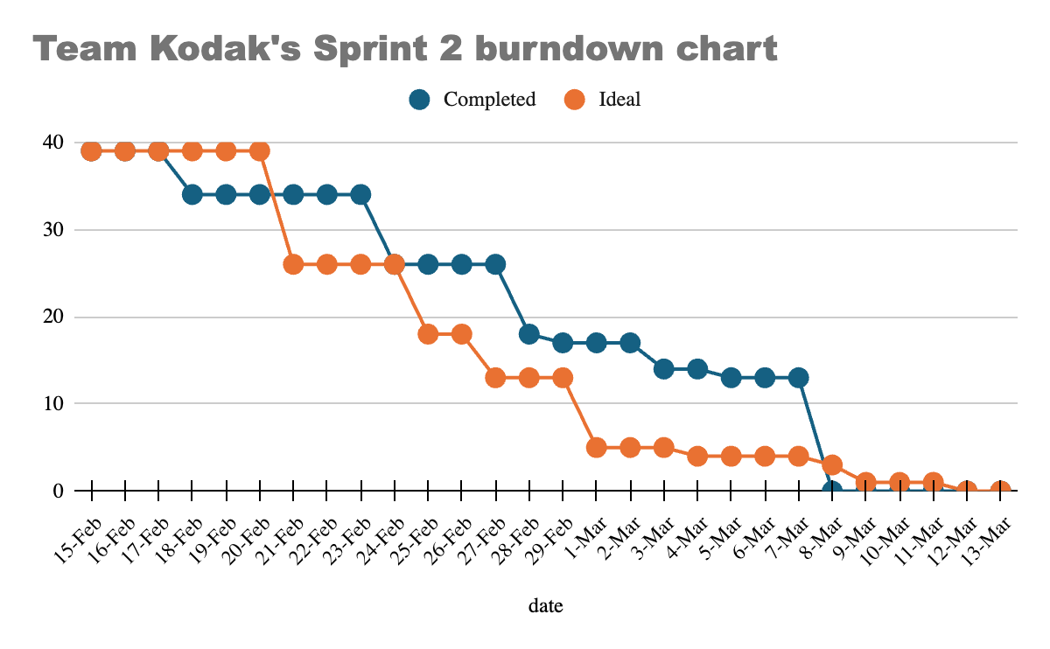
HISTORICAL BURNDOWN CHARTS

Slide 51
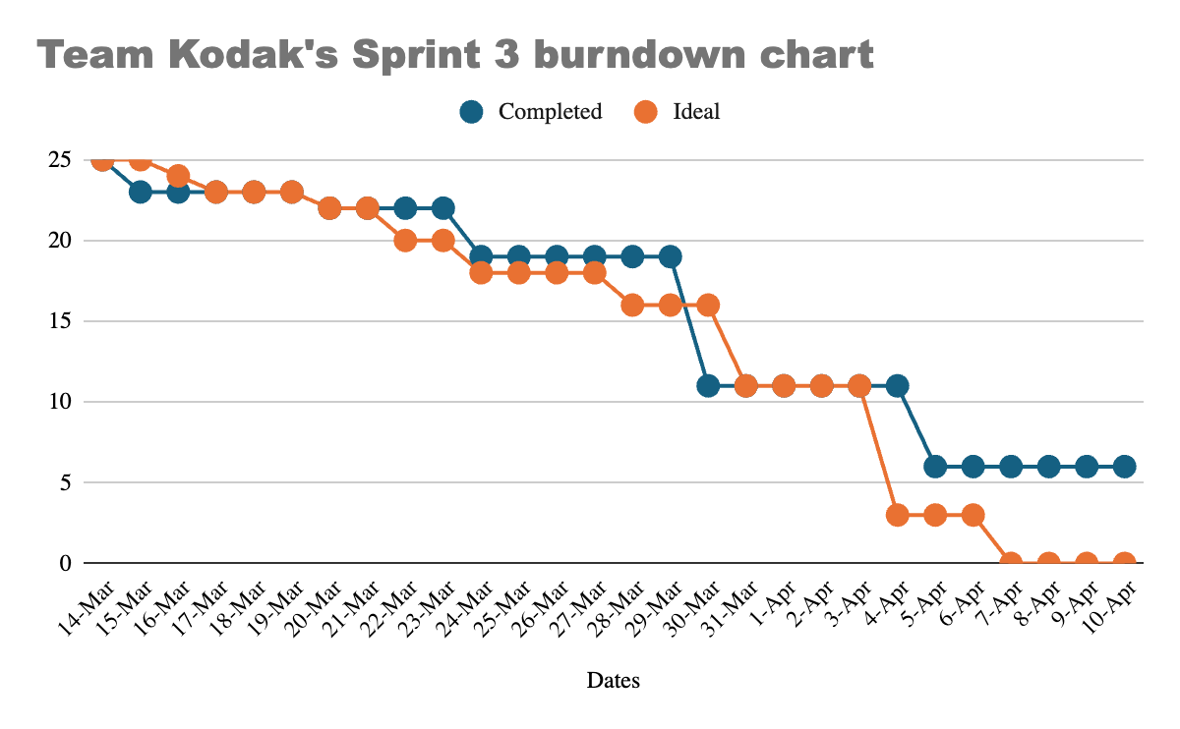
HISTORICAL BURNDOWN CHARTS
CONT.

Slide 52
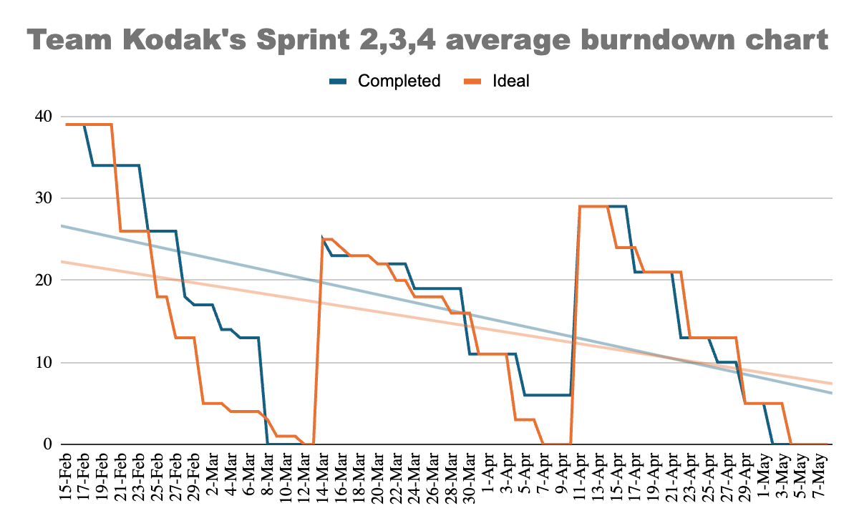
AVERAGE BURNDOWN CHART

Slide 53
SPRINT 4 COMMITTED AND COMPLETED RATIO
Sprint 4 stories | Story points | completed dates | status
As a user i want to see a relevance score of the job and my profile | 13 | May 07, 2024 | completed
As a user i want all the job recommendations in one place | 8 | Apr 27, 2024 | completed
As a user i want to be able to browse through all available jobs in a single place (Infinite scrolling of the same page) | 3 | Apr 27, 2024 | completed
As a user i want to be able to get all the details of the job (Job descriptions of the provided job list.) | 5 | May 07, 2024 | completed
100/100 = 100 % completion

Slide 54
HISTORICAL COMMITTED AND COMPLETED RATIO
Sprint 2
Sprint 3
Sprint 4
8/9 = 88% Done 88% In progress 12% Not started 0%
29/29 = 100% Done 100% In progress 0% Not started 0%
19/25 = 76% Done 76% In Progress 20% Not started 4%

Slide 55
Completion ratio = 56/63≈89%
In progress ratio = 6/63 ≈ 9%
Not completed ratio = 1/63 ≈1%
AVERAGE COMMITTED AND COMPLETED RATIO

Slide 56
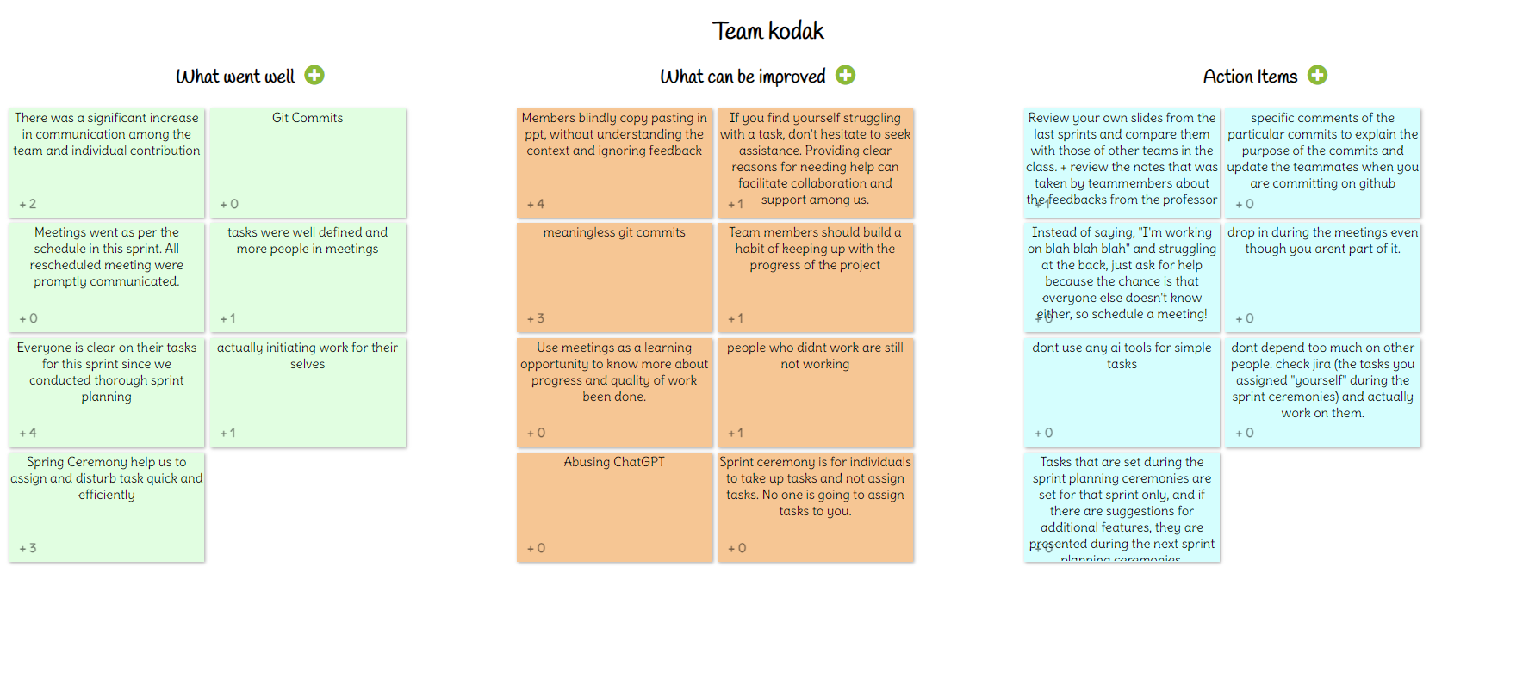
RETROSPECTIVES

Slide 57
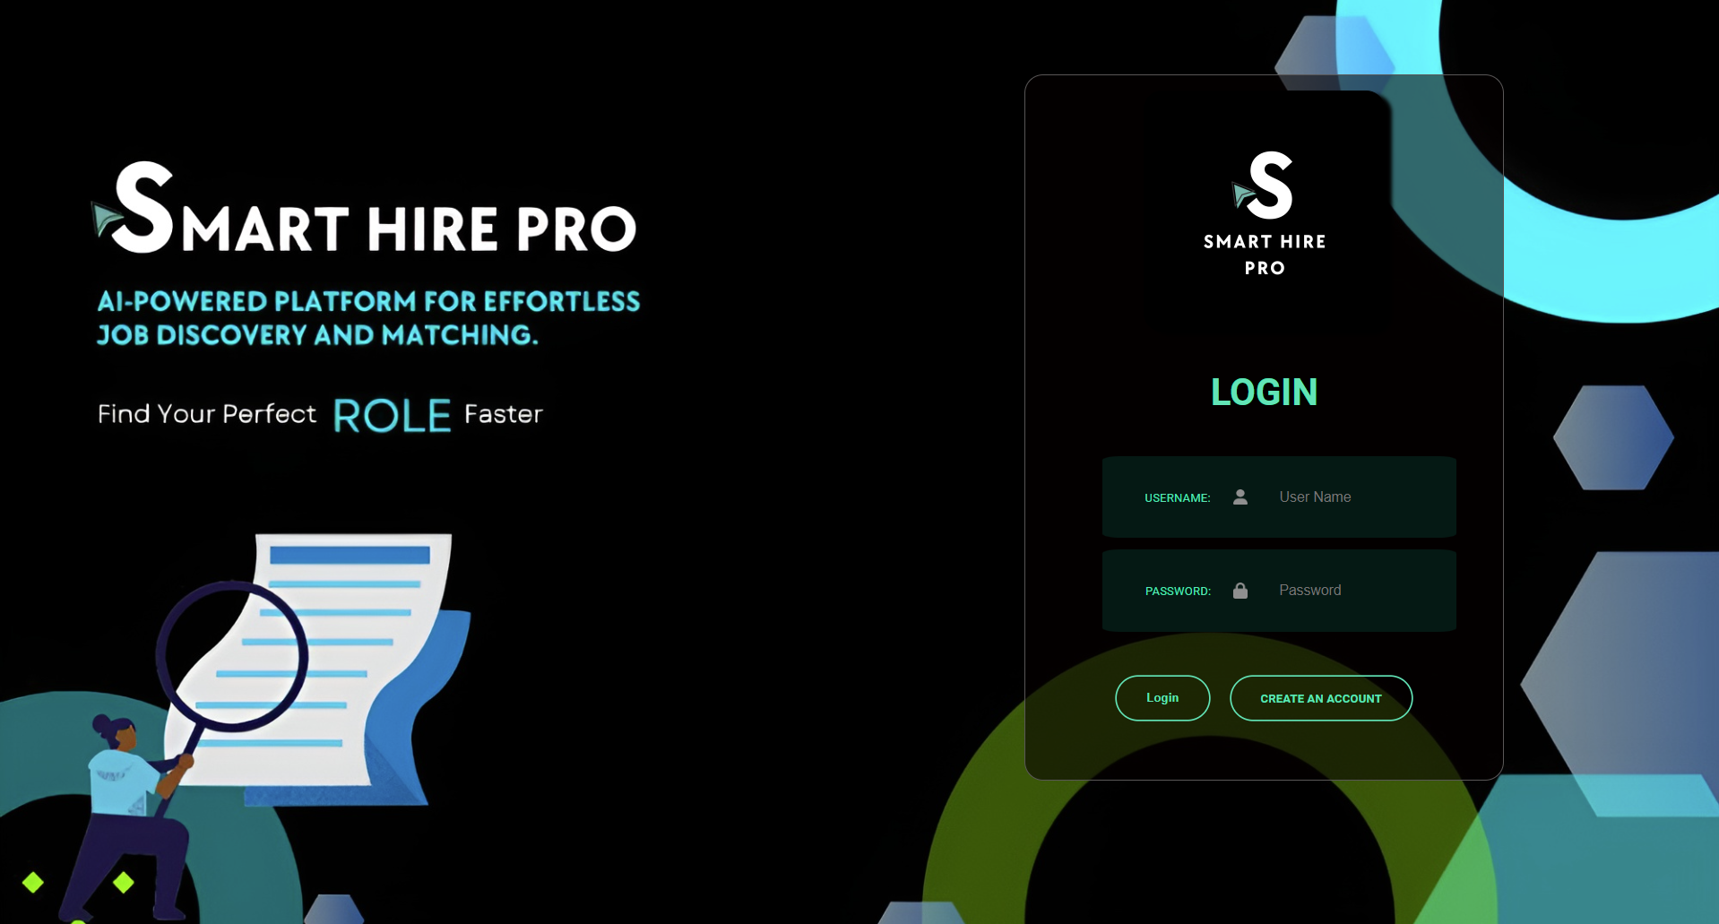
Screenshot - Login

Slide 58
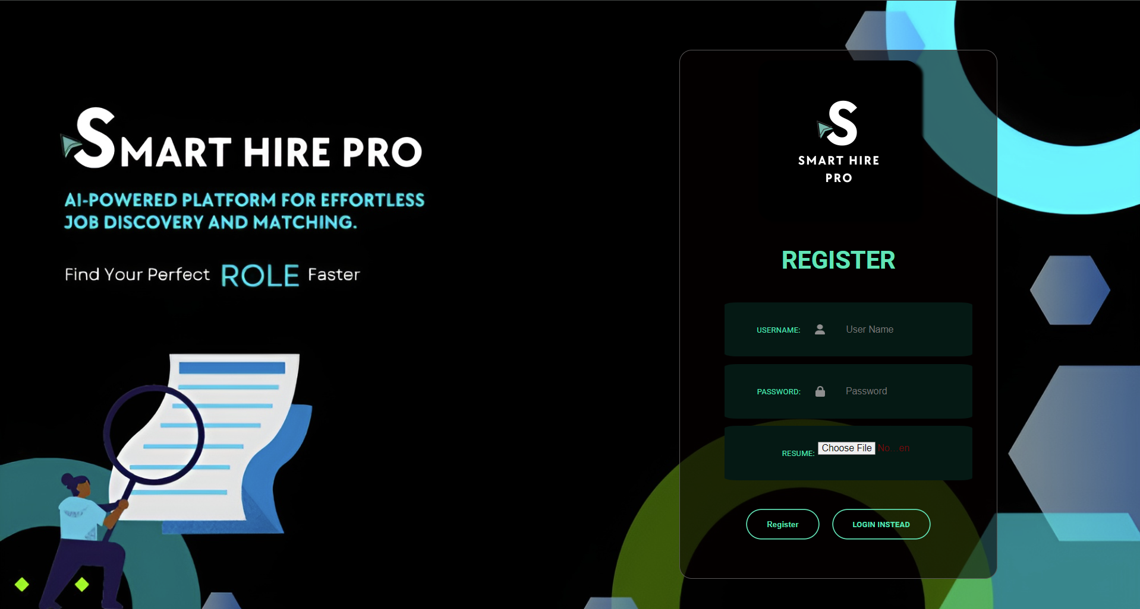
Screenshot - Register

Slide 59
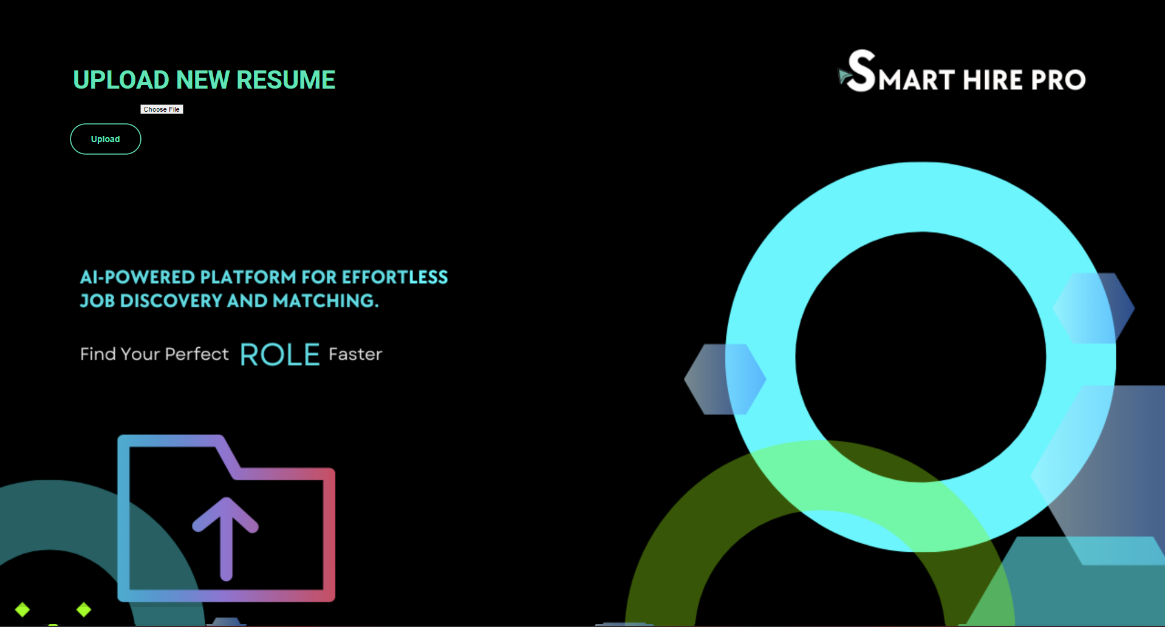
Screenshot - Upload Resume

Slide 60
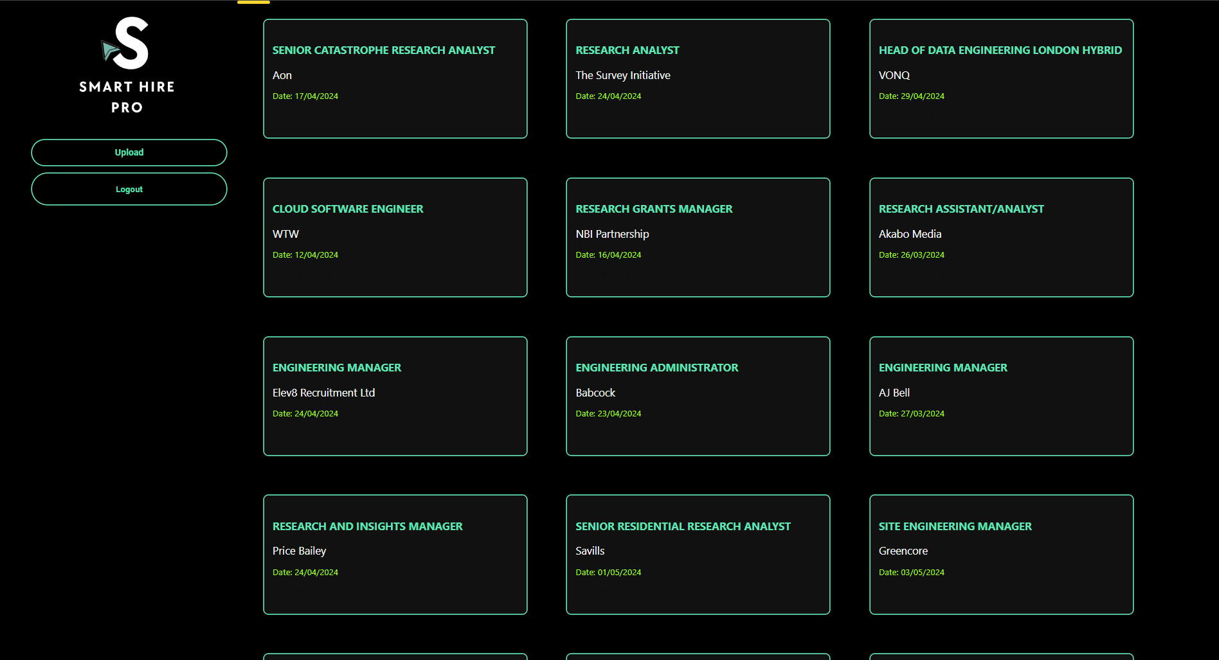
Screenshot - Dashboard

Slide 61
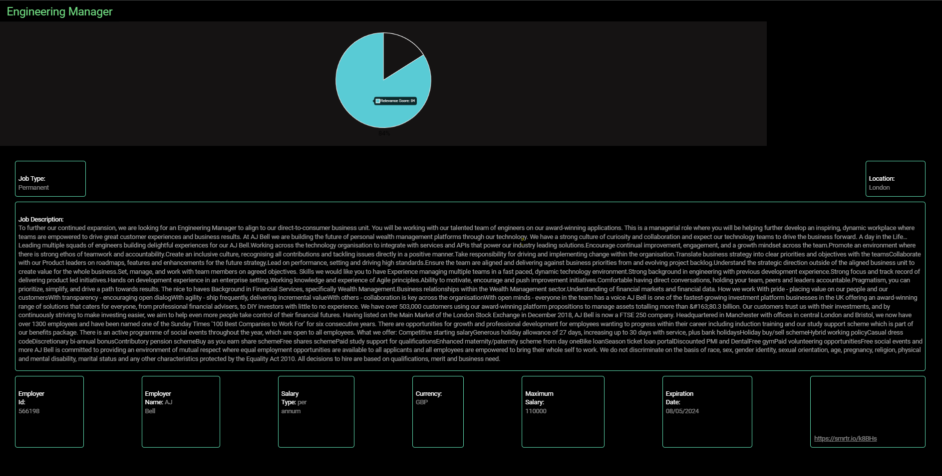
Screenshot - Job Details

Slide 62
API
Login
Register
Endpoint : /userauth/login
Parameters :
Username
Password
Endpoint : /userauth/register
Parameters :
Username
Password
Resume
Resume Upload
Logout
Endpoint : /resume/upload
Parameters :
Username
Resume
Endpoint : /userauth/logout
Parameters :
Username

Slide 63
API
Job List
Job Details
Endpoint : /jobs/list
Parameters :
Username
Page
Endpoint : /jobs/detail
Parameters :
Job ID
Relevance Score
Endpoint : /jobs/score
Parameters :
Username
Job Description

Slide 64

TEAM KODAK GITHUB
https://github.com/htmw/2024S-Kodak/wiki

Slide 65

Thank you!
Do you have any questions?

